Slide 1


Smart Garbage Monitoring System
Designing Circuit in Software
Prepared by:
Kunjalben Patel(C0754858)

Slide 2
Description of the Project:
This project shows the design and development of smart green environment of garbage monitoring system by measuring the garbage level in real time.
LPC1768 is used for controlling the whole system.
We have used ultrasonic sensor to measure the level of garbage in the system.
The LCD module is used to know the percent of garbage in the bin.
The status of garbage will be sent to ThingSpeak over Wi-Fi and to waste management system via GSM Module.
Once the management system knows the level of actual garbage, the waste can be removed from the bin.

Slide 3
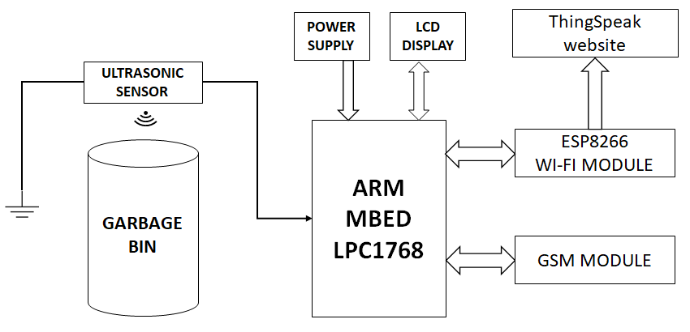
Block Diagram

Slide 4


EASY EDA
EasyEDA is an easier and powerful online PCB design tool that allows to design and share projects.
It has simple, Easier, Friendly, and Powerful general drawing capabilities
It has features to make PCB Layout
We can also design Schematic Capture
SPICE for circuit simulation
It provides more than 1 Million Free Libraries
It has integrated PCB fabrication
Compatible with MAC, windows and Linux
Provides thousands of Open source projects

Slide 5
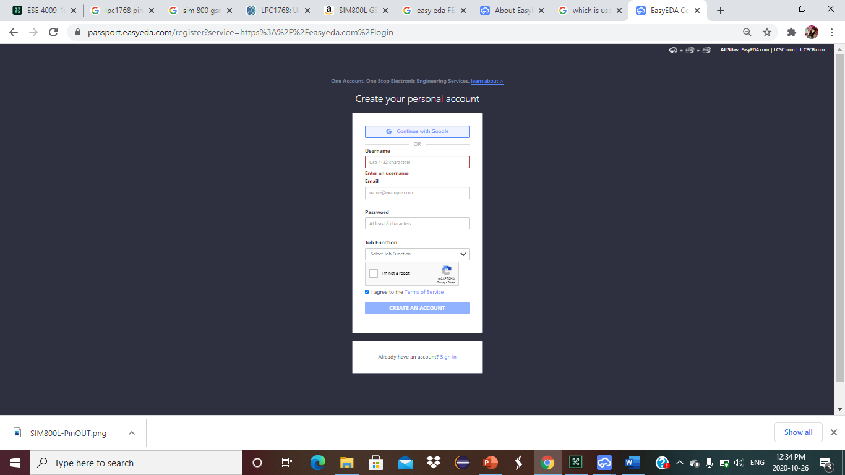
Register for Easy EDA
We can sign up here by creating an account.
Just type user id, set password and enter your email-id.
Account will be created on Easy EDA.

Slide 6
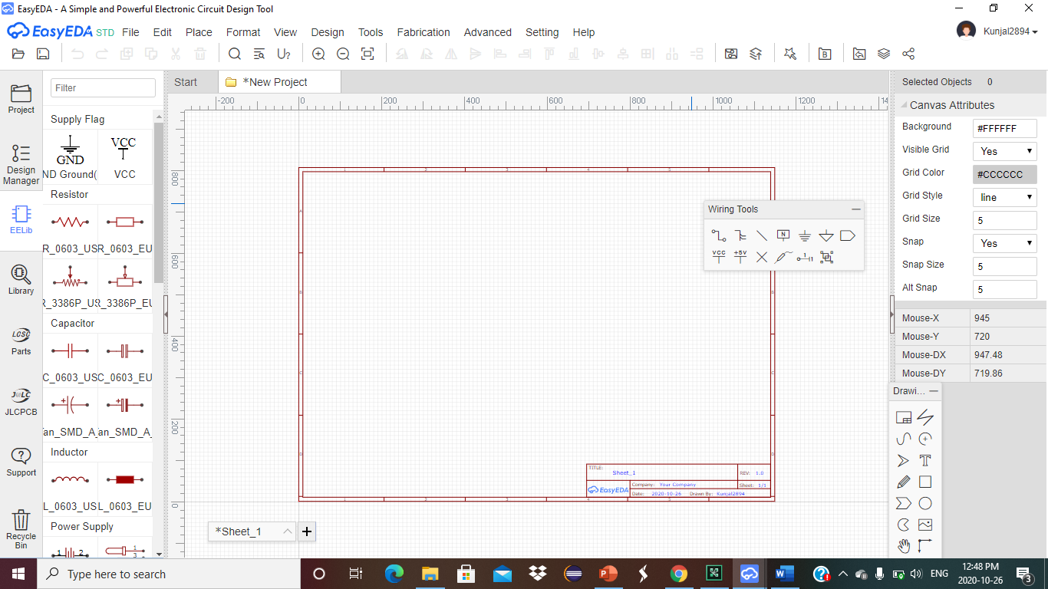
Layout of Easy EDA
EElib contains ready made symbols for wide range of components
Design manager shows the components and nets that used
We can find components in Library
We can buy components using LCSC parts
JLCPCB is used for order PCB.

Slide 7
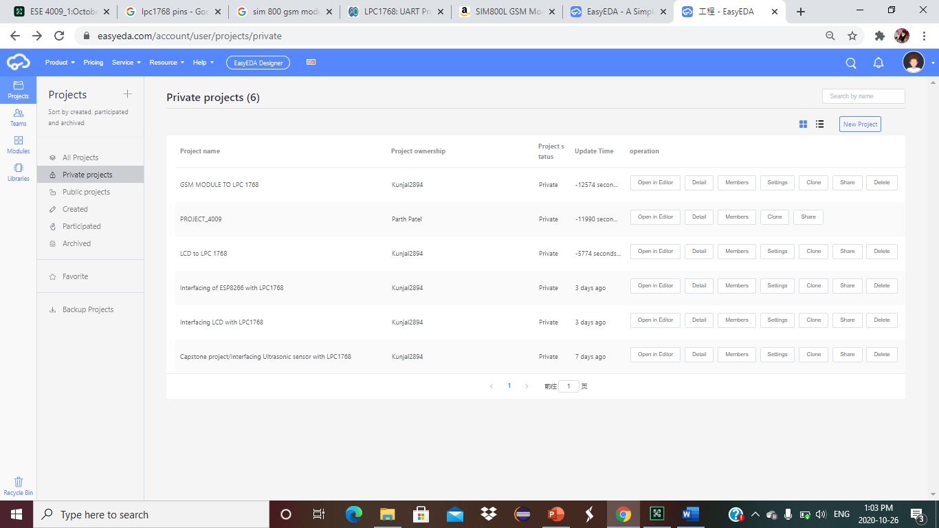
Create a team

Slide 8
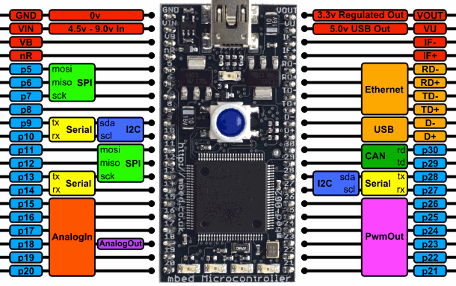
Pinout of LPC 1768

Slide 9
Interfacing Ultrasonic Sensor with LPC1768
For our project, we are using HC-SR04 ultrasonic sensor which works on the principle of SONAR and RADAR system.
Ultrasonic Sensor operates on 5.0V power supply.
It can be used to determine distance of an object in the range 2cm-400cm.
This module has only 4 Pins, VCC, Trig, Gnd and Echo.
We are using GPIO pins to interface Ultrasonic sensor with LPC1768.

Slide 10
Interfacing Ultrasonic Sensor with LPC1768
The GND pin of ultrasonic sensor is connected to Ground.
The TRIG pin of ultrasonic sensor is connected to p20 of LPC1768.
The Echo pin of ultrasonic sensor is connected to Gnd via two resistors.
VCC of Ultrasonic Sensor is connected to p39 of LPC1768.

Slide 11
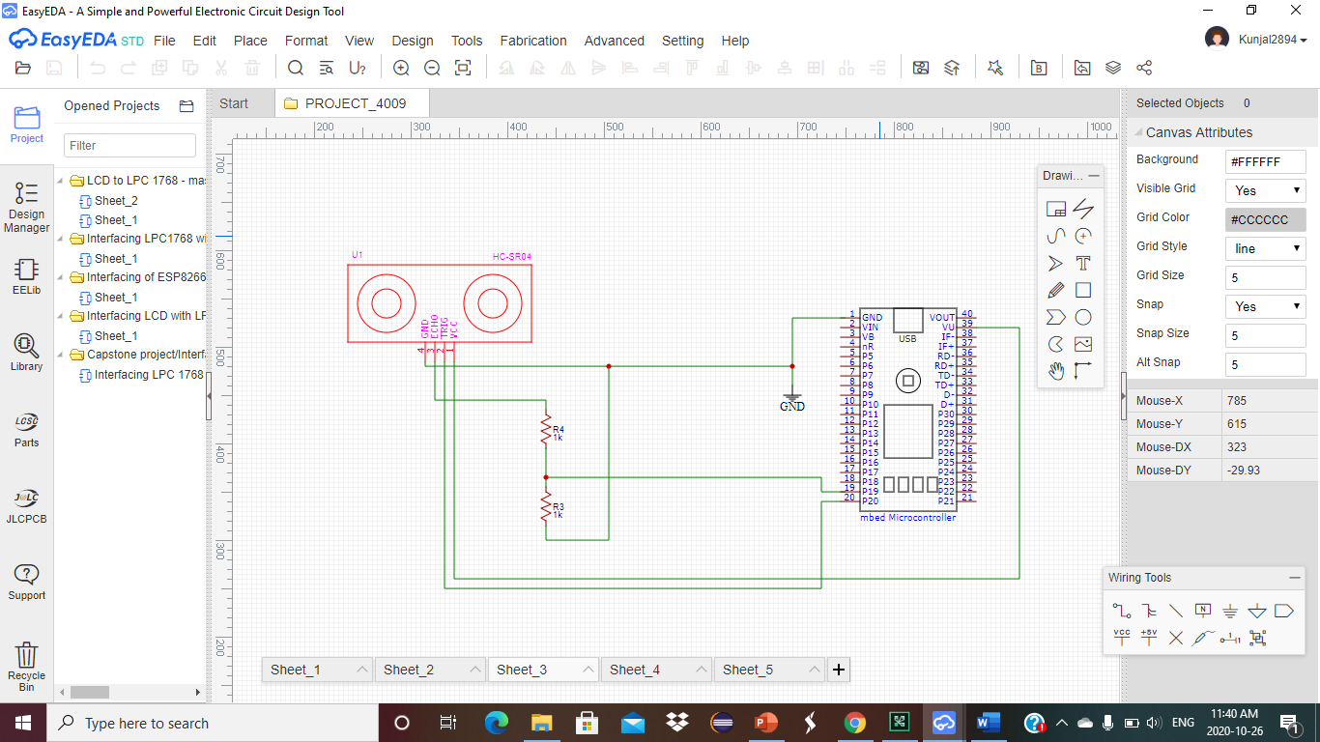
Interfacing Ultrasonic Sensor with LPC1768

Slide 12
Interfacing LCD to LPC1768
We are using LCD-14073 for our project.
The operating voltage for LCD-14073 is 5V.
We are using I2C protocol to interface LCD to LPC1768.
LCD 16*2 can be used in 4 bit or 8 bit mode, but we are using 4-bit mode for our project.
We can print up to 32 characters in two parallel lines.

Slide 13

Interfacing LCD to LPC1768
The VSS pin of LCD is connected to Ground pin of LPC1768.
The VDD pin of LED is connected to P39 of LPC1768.
The P5 of LPC1768 is connected to RS pin of LCD.
The Enable pin of LCD is connected to P6 of LPC1768.
The DB4-DB7 pins of LED is connected to P7-P10 of LPC 1768.
The BLA pin of LCD is connected to p39 of LPC1768.
The BLK pin of LCD is connected to GND of LPC 1768.
The RW pin is connected to GND of LPC1768.

Slide 14
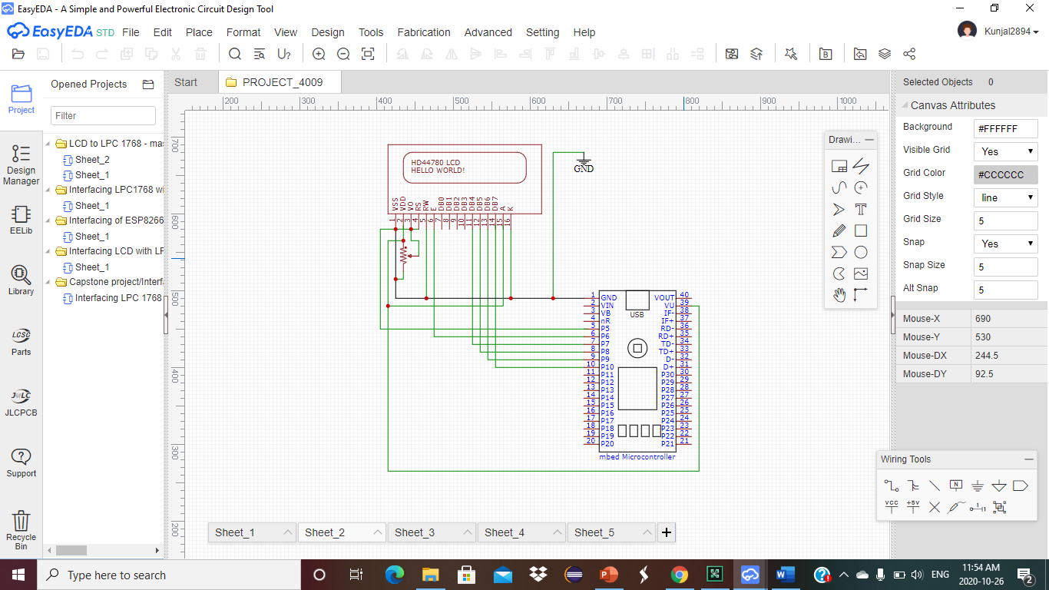
Interfacing LCD to LPC1768

Slide 15
Interfacing of LPC1768 with ESP8266
ESP8266 module comes pre-programmed with an AT command set firmware.
ESP8266 requires an external 3.3V power supply.
ESP8266 is integrated with TCP/IP protocol stake.
It has 4MB flash memory.
We are using UART for interfacing ESP8266 with LPC 1768.

Slide 16
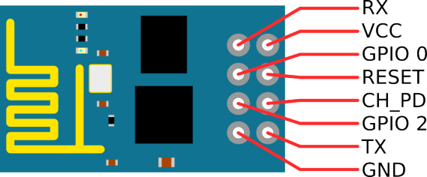
Interfacing of LPC1768 with ESP8266

Slide 17
Interfacing of LPC1768 with ESP8266
We have connected GND pin of ESP 8266 to GND of LPC 1768.
The Rx pin of ESP 8266 is connected to P27 of LPC 1768.
The Tx pin of ESP 8266 is connected to P28 of LPC 1768.
The Enable and 3.3V of ESP 8266 is connected to P40 of LPC 1768.
The P40 of LPC 1768 gives 3.3V regulated out.

Slide 18
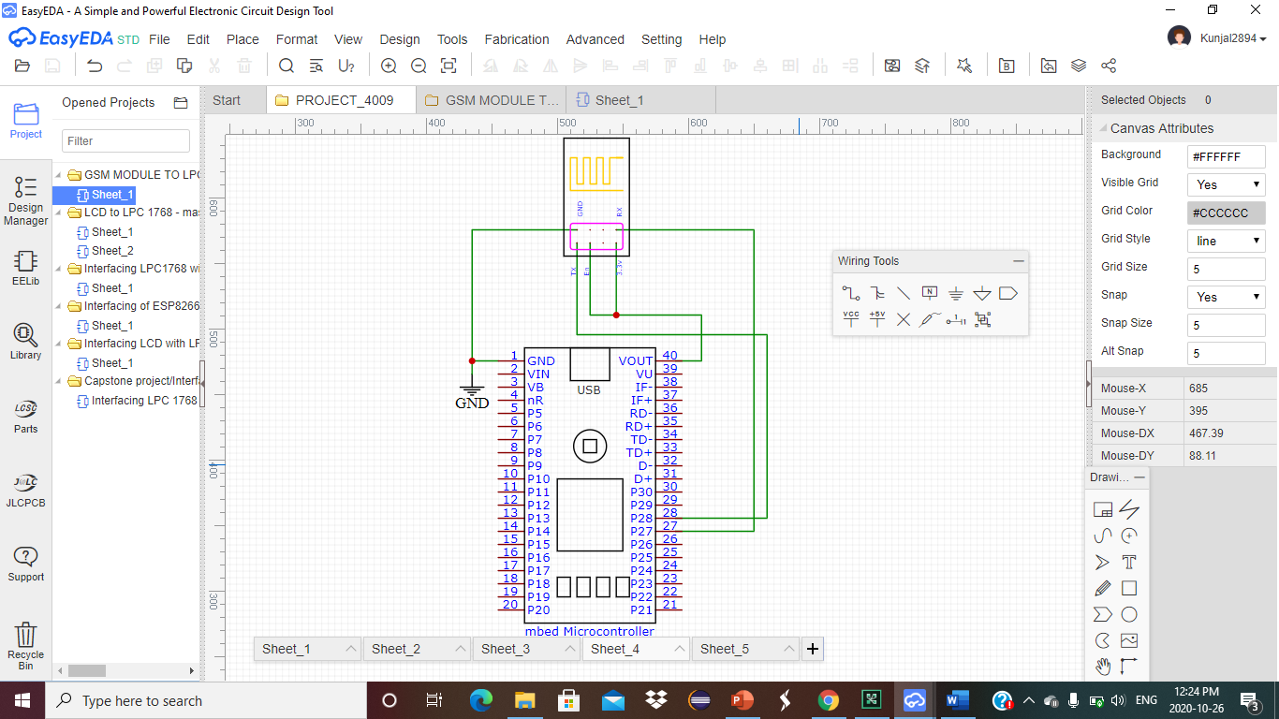
Interfacing of LPC1768 with ESP8266

Slide 19
Interfacing GSM module with LPC 1768
We are using SIM 800L GSM Module.
This SIM800l module has a set of TTL level serial interface, a set of power supply interface.
It supports network of Quad-Band 850 / 900/ 1800 / 1900 MHz, it can transmit Voice, SMS and data information with low power.
It operates on 3.3V to 5V.
We are using UART communication to interface GSM module with LPC 1768.

Slide 20
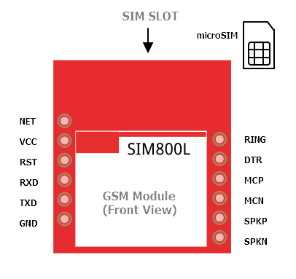
GSM Module

Slide 21
Interfacing GSM module with LPC 1768
We have connected VCC of GSM module to P40 of LPC 1768.
The Rx pin of GSM module is connected to P13 of LPC 1768.
The Tx pin of GSM module is connected to P14 of LPC 1768.
The GND pin is connected to GND of LPC 1768.

Slide 22
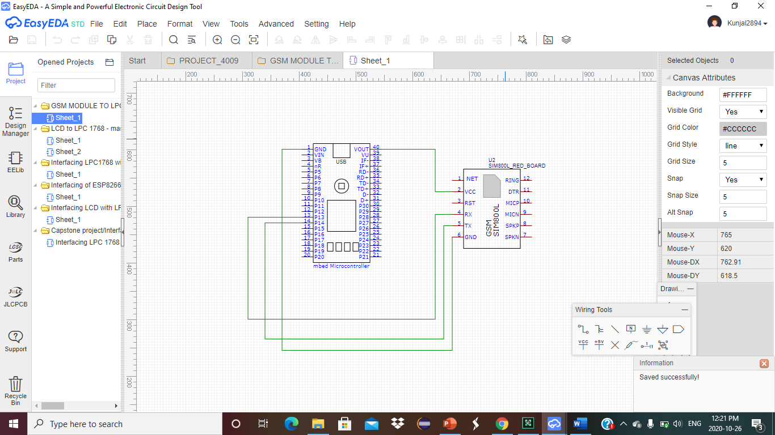
Interfacing GSM module with LPC 1768

Slide 23
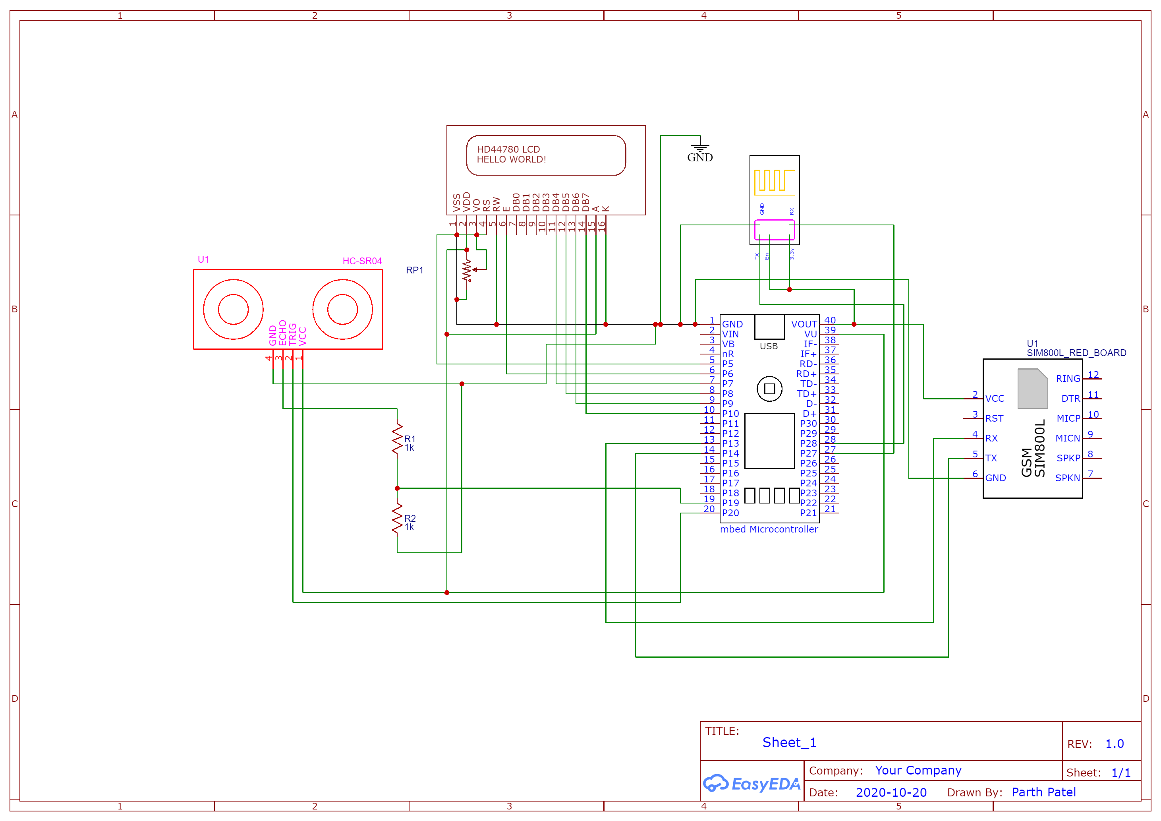
Software Design

Slide 24
References
LCD 16x2 Interfacing With ARM MBED: MBED. (n.d.). Retrieved October 26, 2020, from https://www.electronicwings.com/mbed/lcd-16x2-interfacing-with-arm-mbed
Ultrasonic Sensor HC-SR04 Interfacing With ARM MBED: MBED. (n.d.). Retrieved October 26, 2020, from https://www.electronicwings.com/mbed/ultrasonic-sensor-hc-sr04-interfacing-with-arm-mbed
Home. (n.d.). Retrieved October 26, 2020, from https://www.pantechsolutions.net/how-to-interface-gsm-with-lpc2148-arm
Using the ESP8266 to add Wi Fi to the mbed LPC1768. (2015, December 23). Retrieved October 26, 2020, from https://os.mbed.com/users/4180_1/notebook/using-the-esp8266-with-the-mbed-lpc1768/

